Slide 1
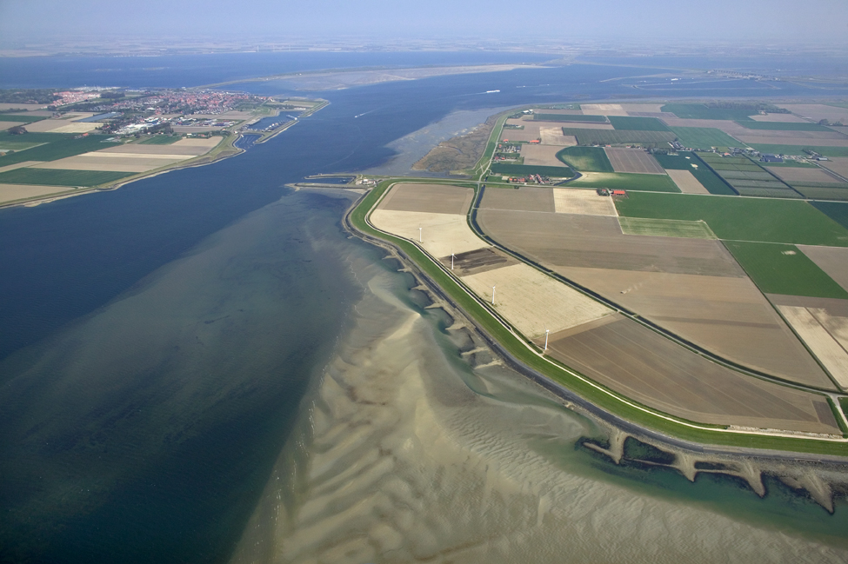


How to run a model in FEWS

Slide 2
FEWS Modules and Workflows

Slide 3
General Module layout
anyModule
Request data
from datastore
Do something …
Write data
to datastore

Slide 4
Modules and Module Instances
Modules are
FEWS plug-ins that can be used in a workflow
registered in ModuleDescriptor file as Java Classes
part of the system configuration
Module Instances are
configured modules of a particular module
registered in ModuleInstanceDescriptors file
part of the regional configuration
Module | ModuleInstance
Import | HIRLAM data CSV data NetCDF…
Trans-formation | Temporal Interpolation Spatial Interpolation Aggregation User Defined Transformation…
General Adapter | Running a model, e.g. SOBEK, MIKE, HBV… Running a script, e.g. R, Python …
Export | To HTML To XML…

Slide 5
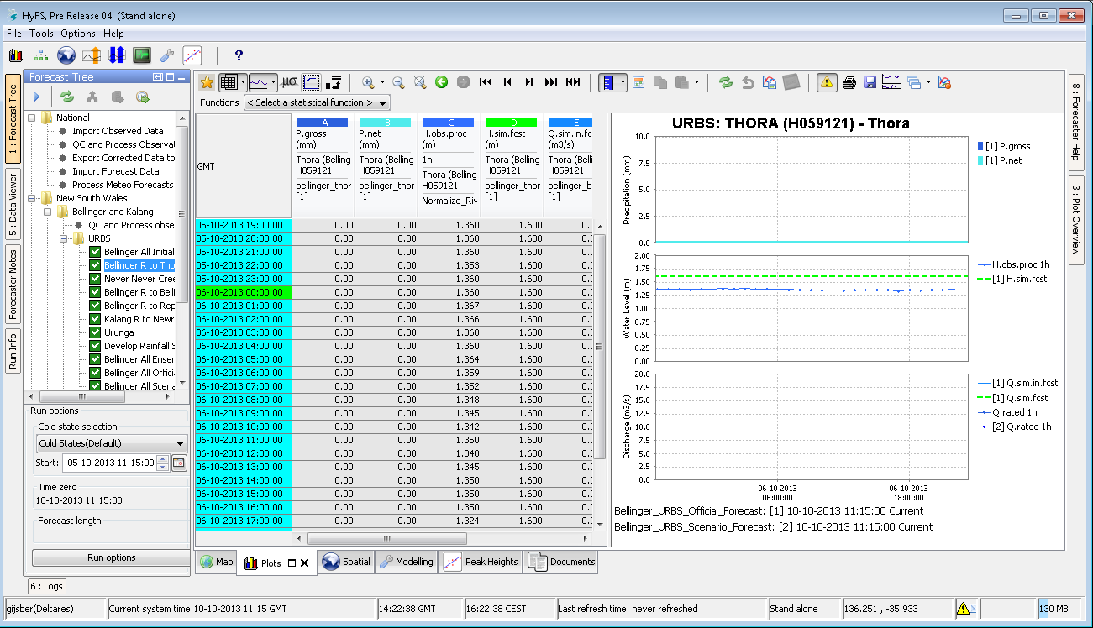
Workflow – FEWS concepts
Module instance - defines processing step
Workflow - Logical sequence of module instances
Task run - Actual execution of a workflow
TimeserieSets connect the dataflow between the module instances
Import
Preprocess
Run Model
Post process
Archive
Export
Report

Slide 6
Workflow types
Manual run
Initiated from an Operator Client (selected & run by an active user)
Scheduled run
Initiated from the Administrator Interface (Master Controller)
Scheduled to run based on a regular interval
Triggered run
Initiated from the Administrator Interface (Master Controller)
Triggered to run based on an ‘event’ (Event Log Message)
Existing run to change in frequency (e.g. more often)
Suspended run to run one-off.

Slide 7
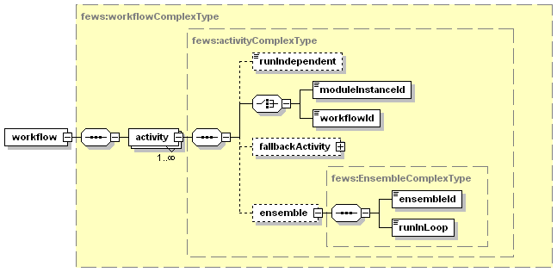
Workflow configuration
Workflows are logical sequences of running forecast modules
Workflows must be registered in the WorkflowDescriptors file
Module Instance ID
Sub-workflows
Run independent
Fallback activity
Ensemble

Slide 8
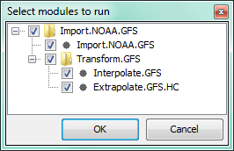
Workflows and sub workflows
Workflows can be nested:
Workflow “Import.NOAA.GFS”
(sub)Workflow “Transform.GFS”
Where:
(sub)Workflow “Transform.GFS”
ModuleInstance “Interpolate.GFS”
ModuleInstance “Interpolate.GFS.HC”

Slide 9
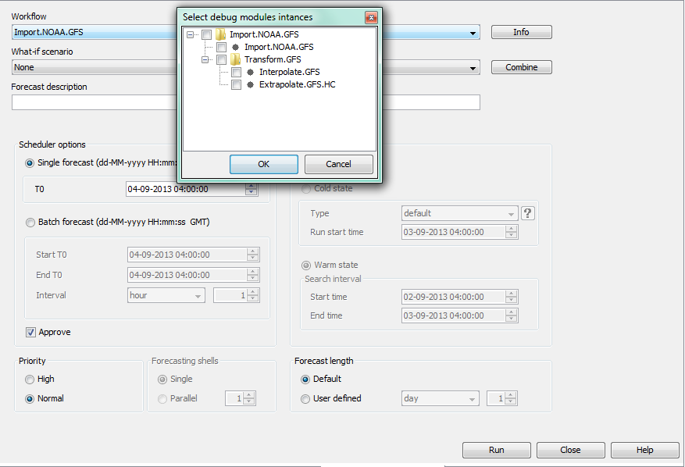
Workflows
Workflows can be run (and debugged) on module basis (ctrl-r or d) in Manual Forecast display

